Slide 1





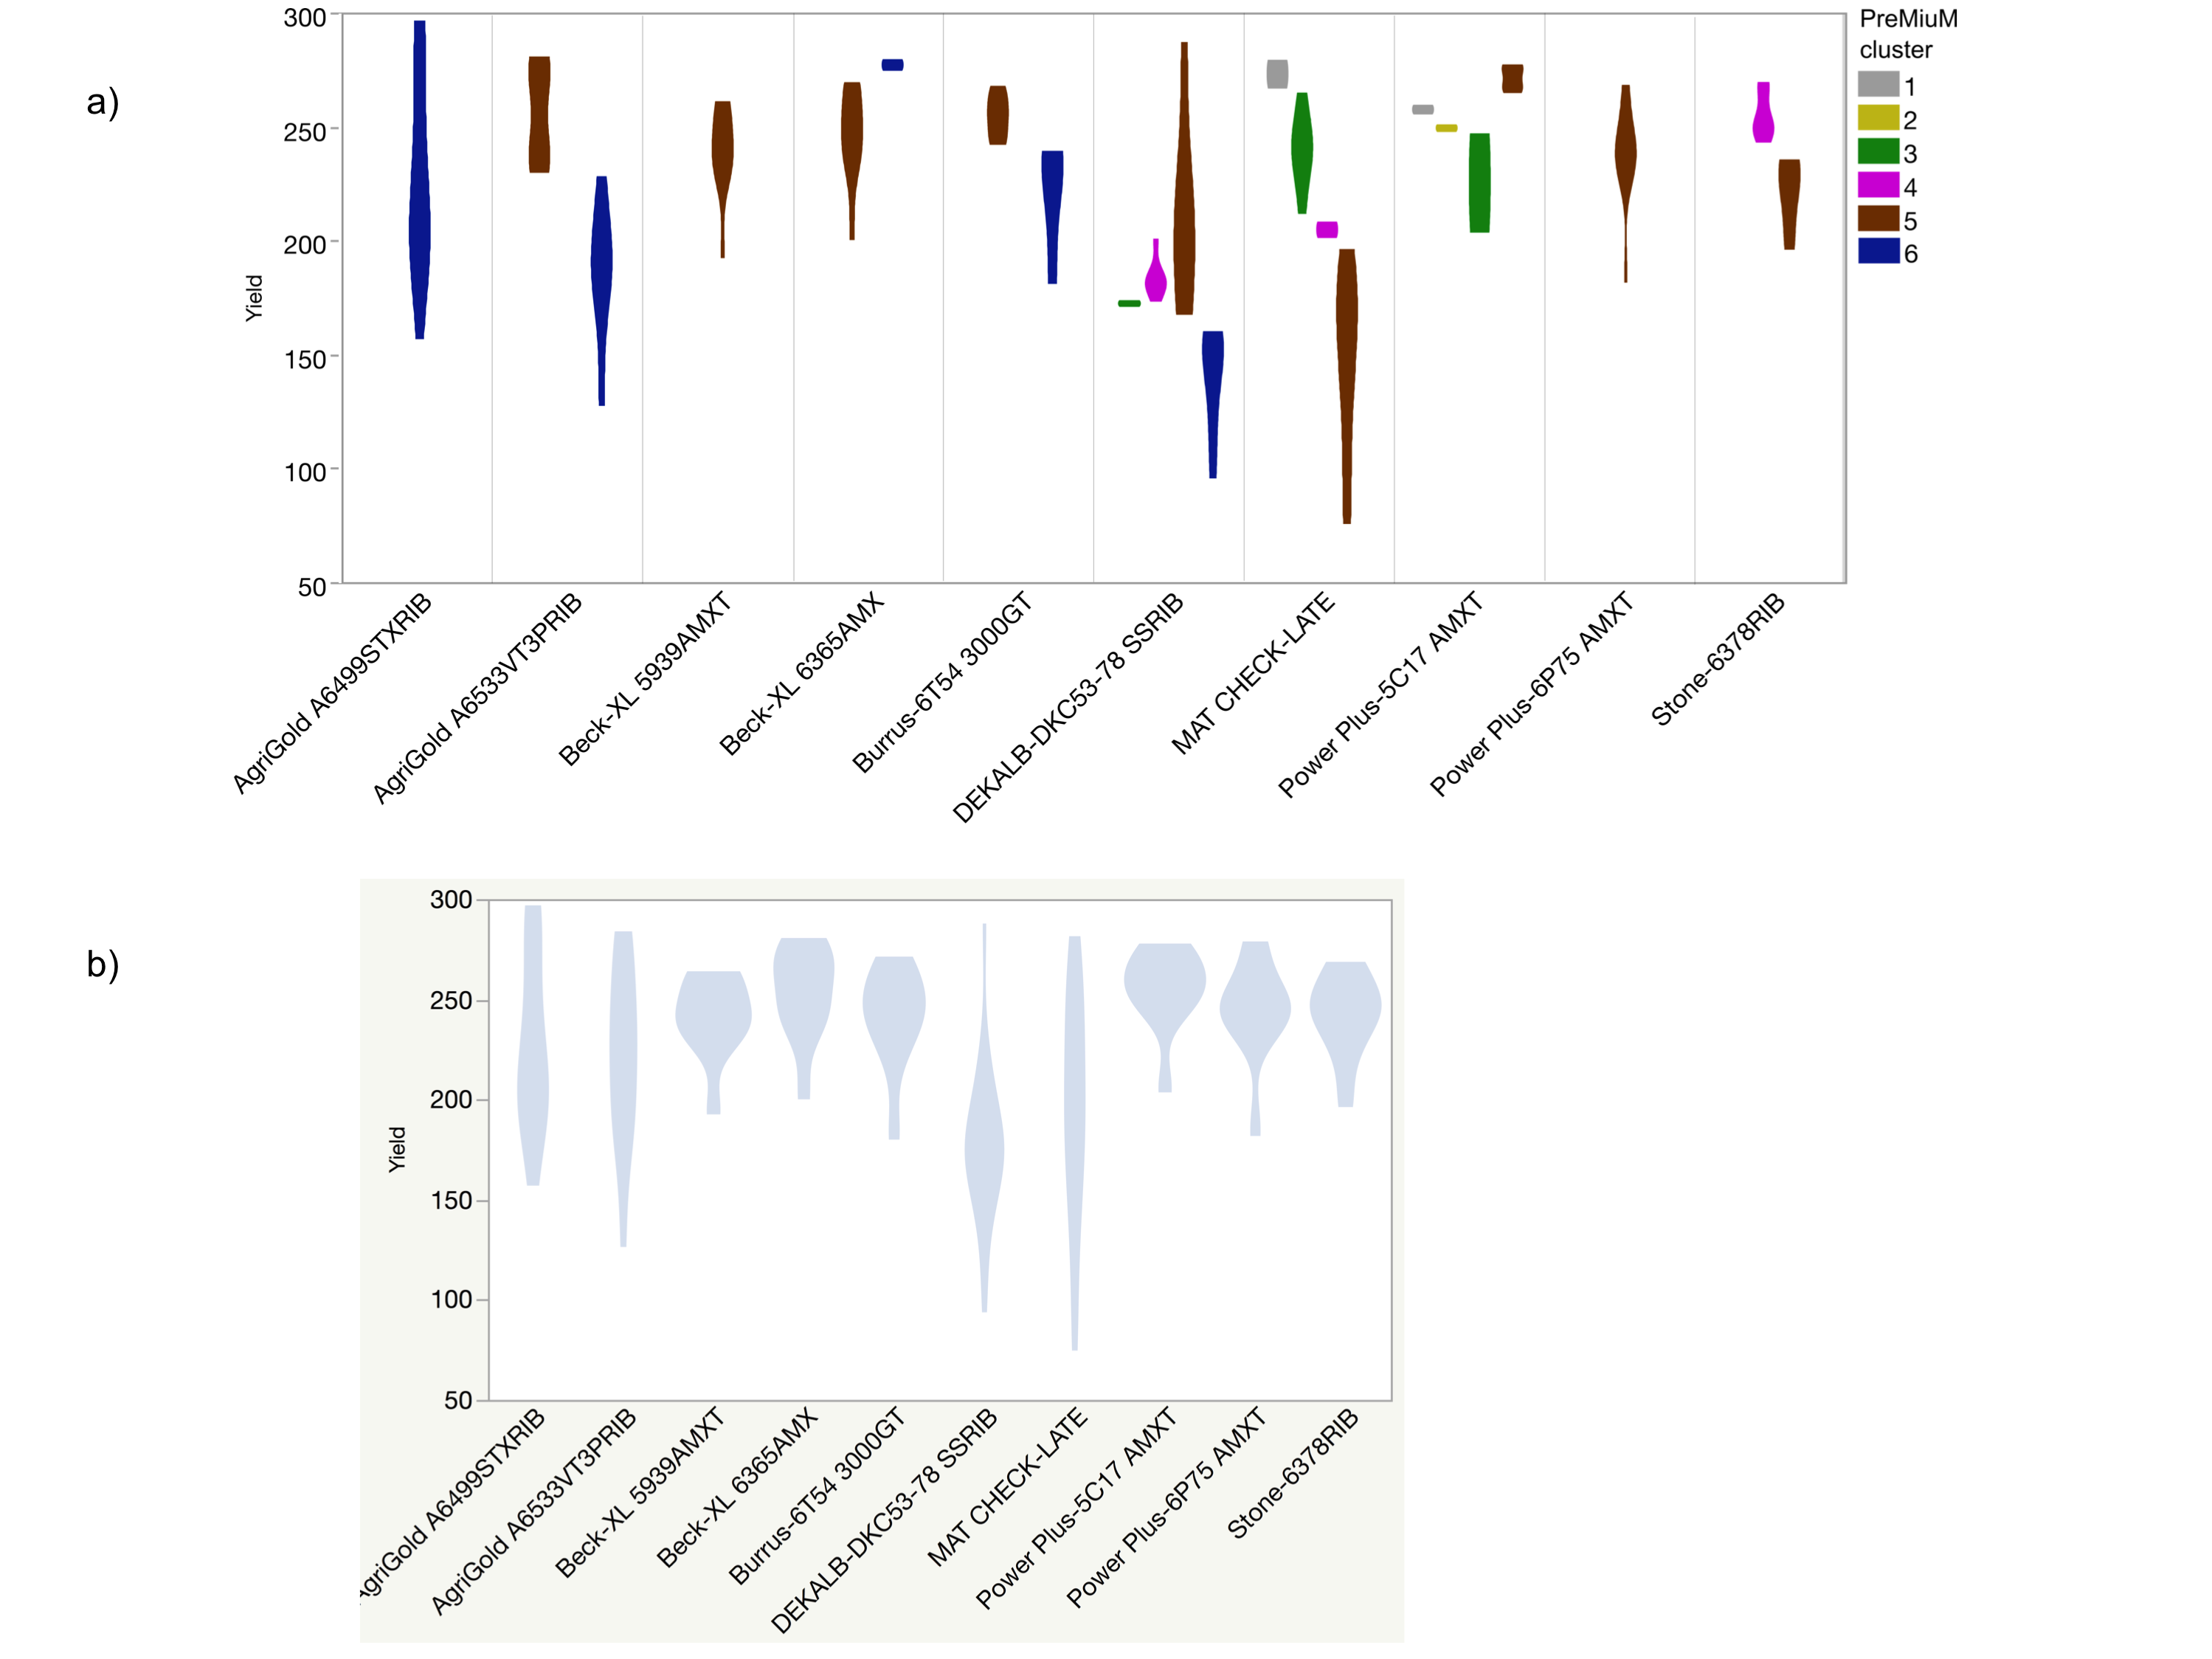
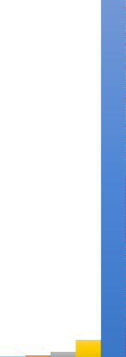
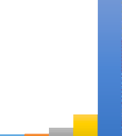
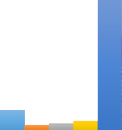

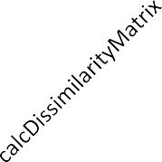
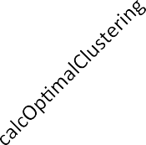


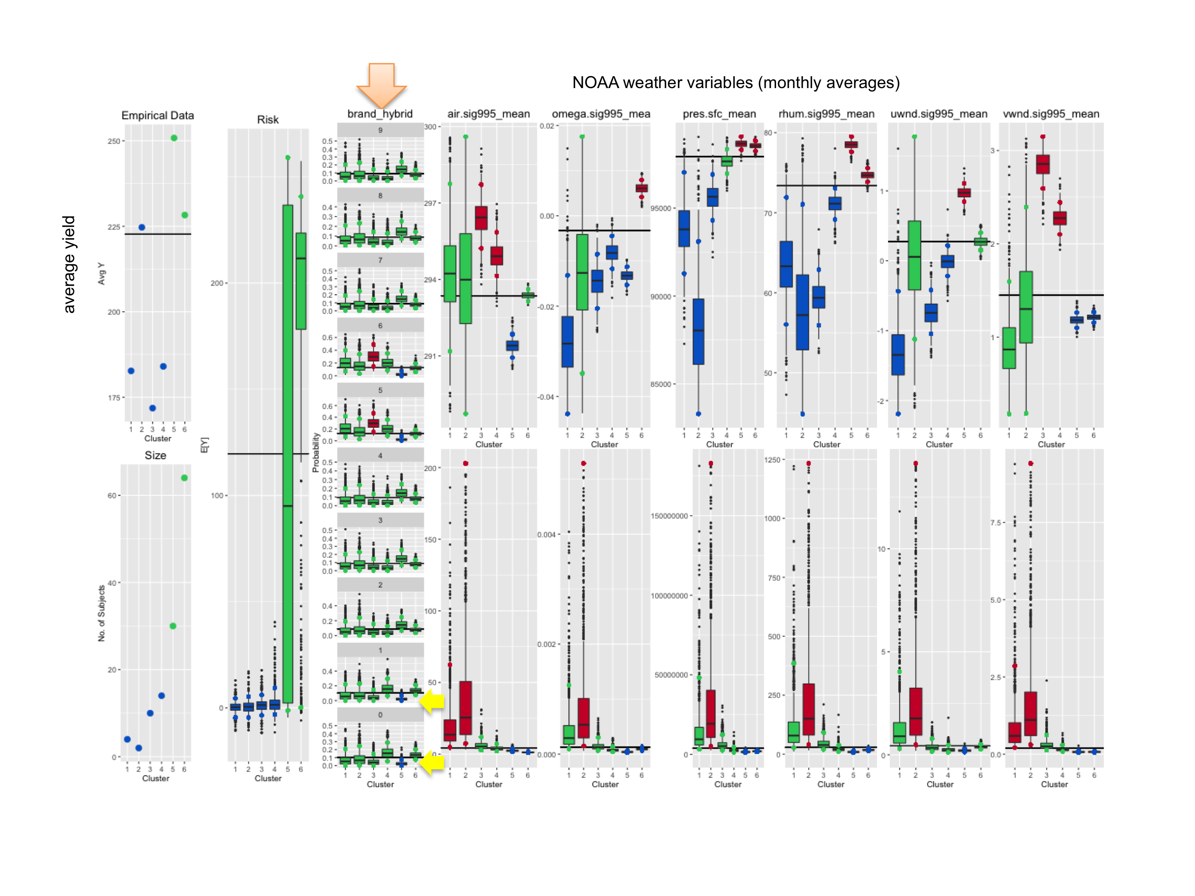


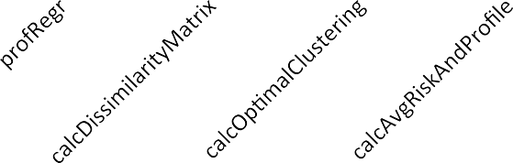

GENETICALLY-INFORMED ENVIROTYPING TOOLS TO BETTER MATCH TEST AND TARGET ENVIRONMENT
Ann E. Stapleton¹, Ruizhu Huang², Austin Gratton¹, Weijia Xu², and Silvia Liverani³, ¹University of North Carolina Wilmington Department of Biology and Marine Biology, ²Texas Advanced Computing Center, Data Mining and Statistics Group, Queen Mary University of London, School of Mathematical Sciences
Summary Our new profile regression analysis methods will provide key tools to plant breeders for better matching their test environment types to their target production environments. Our analysis workflow will enable public and private crop breeders to exploit genotype-environment interactions -- for value-added traits, for specific environments within maturity classes, and for germplasm exchange across networks of smallholders who share similar envirotypes even if they are not physically adjacent. Rather than weighting trials based on a single distance from a hypothetical TPE, our method has the potential to weight by a combination of climate variates that optimally predict the TPE. Our project will also develop relevant genotype-environment known-truth simulations and modeling tools that will enable future development of genotype-by-environment-informed breeding schemes and data analysis methods that can be used by both public and private breeders, and that benefit both large producers and smallholders.
Background
Envirotyping Progress in crop yield improvement relies on the identification of genotypes better adapted to their production environment. However, the complexity of genotype by environment (G x E) interactions slows breeding progress, especially in production environments where complex abiotic stresses are frequent (Chenu, 2015). The process of evaluating germplasm is highly dependent on the relevance of the test environment to the future production environment (Bradshaw, 2016; Chenu, 2015). Breeding program design is constrained by the frequency and extent of suitable predictive test environments within multi-environment trials (Bradshaw, 2016; Cooper et al., 2014). Environment types are based on specific soil-climate–management–genotype combinations rather than on specific physical locations (Chenu, 2015); this explicit information is more predictive than consideration of environments more generally (Malosetti et al., 2016).
Profile regression Traditional regression analyses that attempt to fit main effects and interactions of increasing order to complex datasets quickly become unwieldy and lose power. We adopt a more global point of view, where inference is based on clusters representing covariate patterns as opposed to individual risk factors. Partition and clustering methods are semi-parametric approaches that aim to discretize a multi-dimensional risk surface into cells, also called clusters, having similar risks. These clusters aim to represent groups of individuals that share common characteristics, leading to similar risk profiles. Heterogeneity is thus broken down by augmenting the model with an underlying latent structure that partitions the observations into more homogeneous subgroups or clusters (Liverani et al., 2013, 2015).
The combined effect of climate, soil and genotype variables on crop yield arise from complex mixtures consisting of highly correlated combinations of individual components. PReMiuM/profile regression is a statistical modeling framework that is inherently suitable for modeling highly correlated data. PReMiuM profiling can thus be used to examine patterns of genotype and weather variates and relate these patterns to crop yield. The overall approach is to cluster joint patterns of exposures with inference based on the joint patterns. The methodology consists of the following key components that are described separately but are implemented in a unified Bayesian approach:
1) A profile assignment sub-model (which assigns profiles to clusters). It utilizes advanced Dirichlet process mixture-modeling techniques to group the exposure into clusters, allowing the number of clusters to vary.
2) A response sub-model which links clusters of exposure profiles to outcomes of interest via a regression model, taking into account relevant confounders.
The method is fitted jointly using Markov chain Monte Carlo methods.
Breeding Program Simulator
Results
Variety trial data can be clustered into envirotypes using PReMiuM.
Code profiling gave us good targets for speed improvements.
Public Variety Trial Example
Experimental Design
As we input more data, PReMiuM becomes too slow or fails to run. The package is ~quadratic in complexity.
Computational bottlenecks were analyzed with the code profiling tool profvis:
Let us know how we could help you with teaching plant breeding using simulations!
Please comment via this short survey – use a paper survey (below), or snap the QR code, go to https://uncw.az1.qualtrics.com/jfe/form/SV_0kqR5KxuHhHUcbH or https://tinyurl.com/y9w2rb68, or email stapletona@uncw.edu to access the online survey form.
One year (2014)
Locations in Kansas, Missouri, Illinois (five fields per state)
Unbalanced design (not all genotypes/varieties in all fields)
Ten varieties analyzed
Weather covariates from NOAA
--monthly averages of six variables
--retrieved using approximate GPS coordinates from nearest town
PReMiuM clustering of envirotypes:
3 and 4 = poor weather
(high VPD)
This function has nested FOR loops, which can be modified for better performance.
5 = optimal
weather (low VPD)
Next steps
Create known-truth simulations of crossover genotype by environment interaction with realistic correlated covariate structures which combine to generate nonlinear outcome (yield) levels.
These simulations and our documentation and tutorials are always publicly available for use by other algorithm developers and breeders.
Improve the PReMiuM profile regression algorithm run speed and develop breeder-relevant output plots and tables, make the entire pipeline available on public infrastructure (we support ‘mastermind, don’t download’).
Analyze real crop datasets from G2F and T3 with our improved PReMiuM and PReMiuM+linear model workflow, make spatial results maps to visualize the results in an easily interpretable field context.
Develop breeding simulation models that incorporate realistic environment covariate features of test and target environments and flexible, extensible specifications of genetic gain within an open web-accessible modeling system—InsightMaker--to support both student training and advanced breeder modeling of breeding program options to achieve higher yields with relevant constraints.
1500
6
24
48
96
192
1000
500
0
Figure 3 Yield Comparisons Across Public Variety Trials a) Violin plot of PReMiuM cluster assignment by hybrid, showing range of variation and distribution of measured yield values. b) Violin plot of yield by hybrid name; the pale blue cloud indicates the range of yield values.
Figure 1. Runtime(second) for increasing numbers of continuous features across five PreMiuM functions
These are the profiles of the weather covariates.
This plotting function will be relatively straightforward to modify for better performance.
140000
120000
100000
80000
Fig. 2 PReMiuM profile box plots of analysis outputs. Summary plot outputs of PReMiuM analysis, with the PReMiuM clusters shown on the x axis of each graph. Weather variates are, from left to right, air temperature (in Kelvin), wind (omega), air pressure, relative humidity, crosswind velocity, and vertical wind velocity. Blue color indicates less than the overall mean, green color indicates that the value is near the overall mean, and red color indicates that the values are higher than the overall mean. Hybrids are listed by number in the plot headers, as AgriGold A6499STXRIB with 0, AgriGold A6533VT3PRIB with 1, Beck-XL 5939AMXT with 2, Beck-XL 6365AMX with 3, Burrus-6T54 3000GT with 4, DEKALB-DKC53-78 SSRIB with 5, MAT CHECK-LATE with 6, Power Plus-5C17 AMXT with 7, Power Plus-6P75 AMXT with 8, Stone-6378RIB with 9
60000
6
24
48
96
40000
20000
0
References
Bradshaw, J. E. (2016). Plant Breeding: Past, Present and Future. Springer.
Chenu, K. (2015). Characterising the crop environment – Nature, significance and applications. Crop Physiol. Second Ed., 321:348. doi:10.1016/B978-0-12-417104-6.00013-3.
Cooper, M., Messina, C. D., Podlich, D., Totir, L. R., Baumgarten, A., Hausmann, N. J., et al. (2014). Predicting the future of plant breeding: complementing empirical evaluation with genetic prediction. Crop Pasture Sci. 65, 311. doi:10.1071/CP14007.
Liverani, S., Hastie, D. I., Azizi, L., Papathomas, M., and Richardson, S. (2013). PReMiuM: An R Package for Profile Regression Mixture Models using Dirichlet Processes. ArXiv13032836 Stat. Available at: http://arxiv.org/abs/1303.2836 [Accessed July 10, 2016].
Liverani, S., Hastie, D. I., Azizi, L., Papathomas, M., and Richardson, S. (2015). PReMiuM : An R Package for Profile Regression Mixture Models Using Dirichlet Processes. J. Stat. Softw. 64. doi:10.18637/jss.v064.i07.
Malosetti, M., Bustos-Korts, D., Boer, M. P., and van Eeuwijk, F. A. (2016). Predicting Responses in Multiple Environments: Issues in Relation to Genotype × Environment Interactions. Crop Sci. 0, 0. doi:10.2135/cropsci2015.05.0311.
PReMiuM analysis of simulated input clusters with yield and a range of environment types resulted in precise recovery of the input groups. (Simulated data were provided and analyzed by C. Messina and M. Cooper, DupontPioneer.)
Figure 2. Memory allocated(MB) for continuous features (60 random samples) Note: profReg and calcDissimilar call C/C++ code ‘profRegr’ and ‘calcDisSimMat ,so profvis cannot proﬁle the memory usage for these two functions.
Acknowledgements
This material is based upon work that is supported by the National Institute of Food and Agriculture, U.S. Department of Agriculture, under award number 2017-67013-26188.
Notes:
Clusters 1 and 2 include very small number of data points, and have correspondingly high standard deviations (n for each cluster is visible in the bottom left subplot in Fig. 2). Cluster 6 included fields in Kansas, Missouri and Illinois (results not shown), with weather variables that were near the overall average. Cluster 5 included weather conditions related to high yield, such as higher humidity and lower air temperature (Fig. 2). We note that variety by environment crossover interactions were not completely explained by this small data analysis; this is visible in Fig 2, as most hybrids are equally likely to be in all clusters (orange arrow, mid-left hybrid subplot graphs, all green bars in all clusters) except for the Agrigold hybrids 0 and 1 (yellow arrows, with less probability of being in cluster 5) and the hybrids that were only present in Kansas fields (hybrids 5 and 6). This result would be expected in public trials, as commercial breeders would place optimized varieties into such trials. As an example of this phenomenon, the maturity check hybrid in the Kansas trails has much more variable yields across farms than the commercial Dekalb hybrid (Fig. 3b). Our small-scale variety trial data analysis can be used for describing the specific ranges of weather components in the groups of field environments. For example, the high-yielding environments in cluster 5 can be described as low-VPD environments (Gholipoor et al., 2013), and the cluster 3 and 4 fields would be high-VPD environments.

